Slide 1
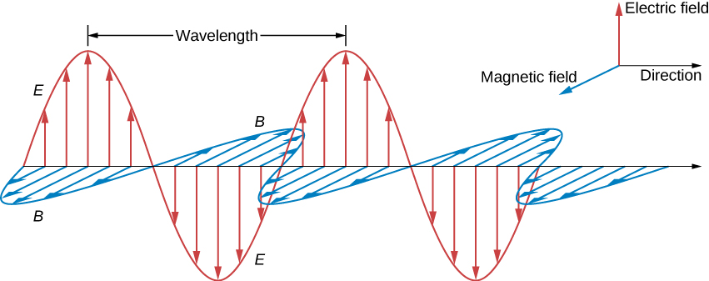

x
Figure 1. Our crude model of an electron on a spring being driven by an electromagnetic wave. The B-field of the wave is neglected and is assumed to be small compared to the external B-field.
z
y

Slide 2

x
Figure 2. The left circle shows the electric field of the wave and its components in the angular basis. The right circle shows how the electric field of the wave changed as it passed through the material.
E+
Ew
E+
Ew
E-
$$∆φ$$
B0
z
E+
E+
E-
y
L

